Slide 1
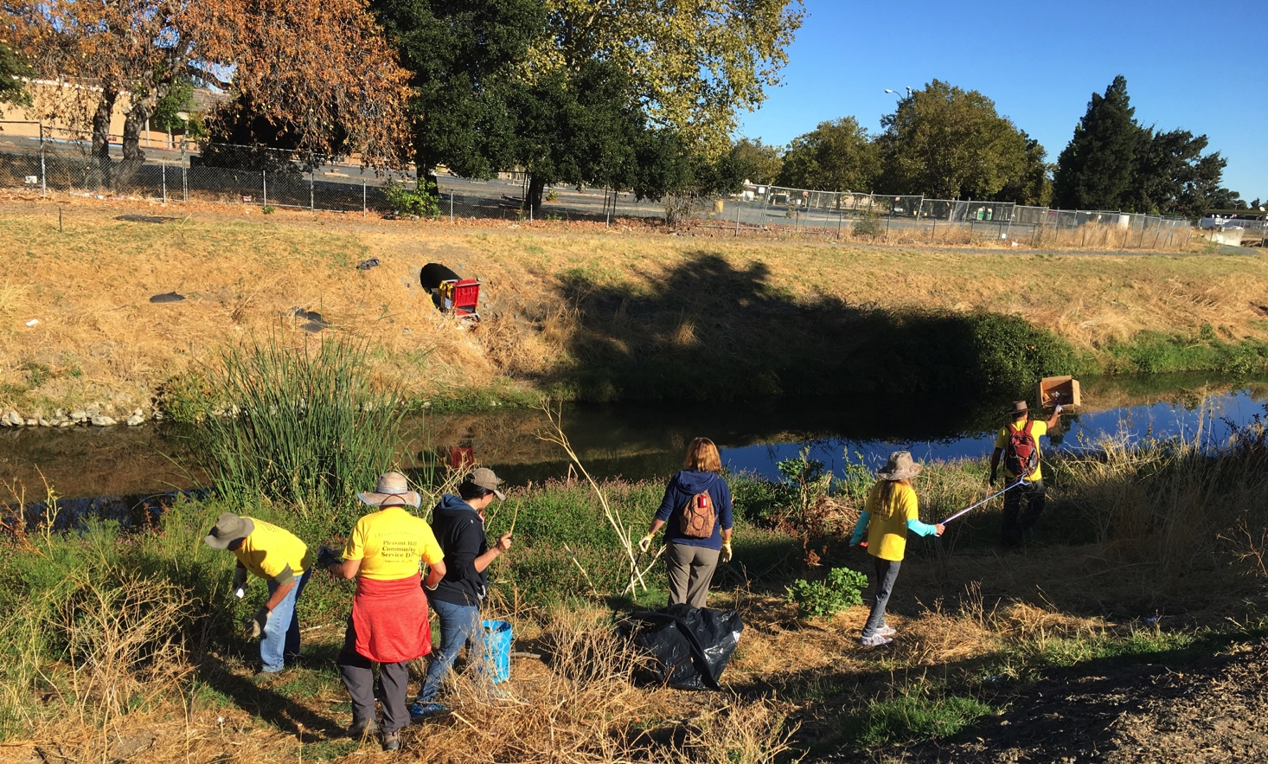
September 23, 2017 | Pleasant Hill, CA
2017 Grayson Creek Cleanup

Slide 2
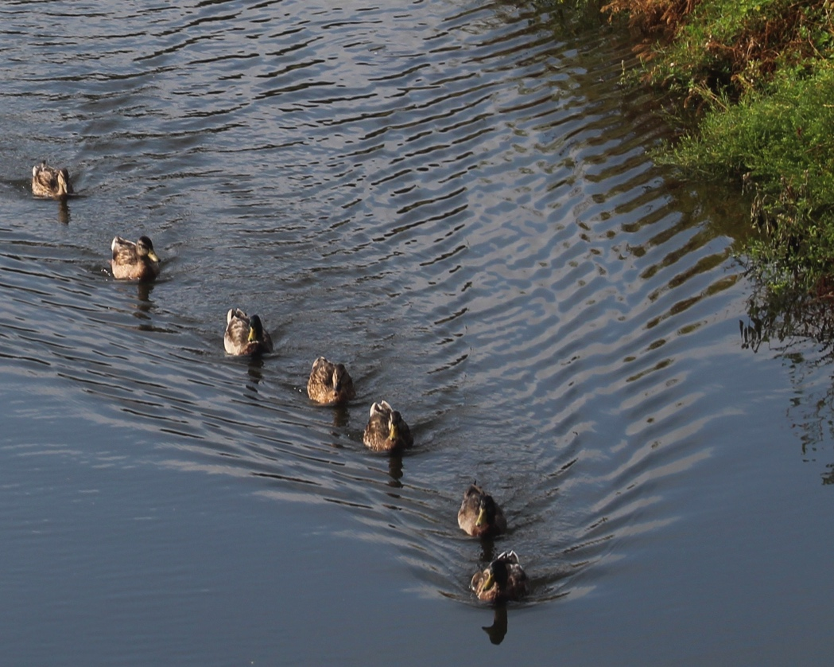
Highlights
1550 feet of Grayson Creek cleaned up between Golf Club Rd and Chilpancingo Pkwy
50+ volunteers
20+ cubic yards of trash removed
10 participating agencies and organizations
Sponsored by the Pleasant Hill Civic Action Commission as part of 2017 Community Service Day

Slide 3
Location

Slide 4
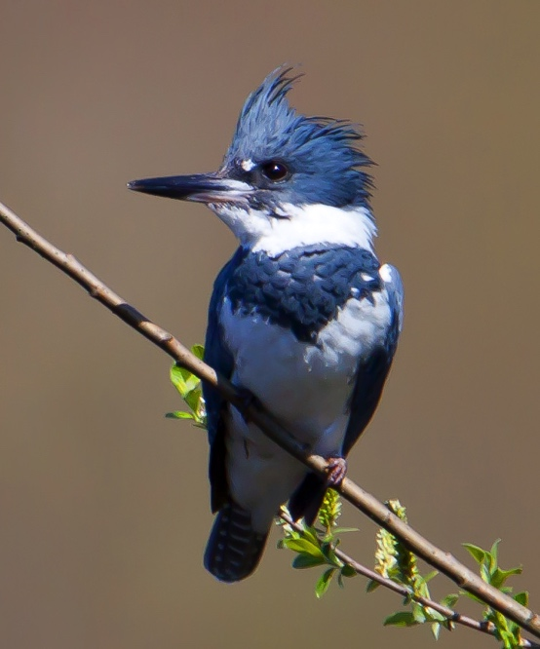
About Grayson Creek
About Grayson Creek
Major tributary of Walnut Creek
Provides flood control and water quality benefits plus habitat for 90+ species of native California birds as well as fish and crustaceans
Important part of the largest watershed in Contra Costa County

Slide 5
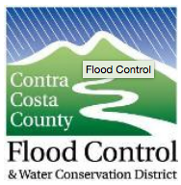
About Grayson Creek
Participating Agencies & Organizations

Slide 6
About Grayson Creek
Before

Slide 7
About Grayson Creek
Before

Slide 8
About Grayson Creek
Before

Slide 9
About Grayson Creek
During

Slide 10
About Grayson Creek
During

Slide 11
About Grayson Creek
During

Slide 12
About Grayson Creek
During

Slide 13
About Grayson Creek
During

Slide 14
About Grayson Creek
During

Slide 15
About Grayson Creek
During

Slide 16
About Grayson Creek
During

Slide 17
About Grayson Creek
After

Slide 18
About Grayson Creek
After

Slide 19
About Grayson Creek
Follow Up: Trash Assessment
Eagle Scout candidate Sean Mitchell compiled data on trash collected during the cleanup.
Results will be shared with responsible agencies and the public via Friends of Pleasant Hill Creeks website.
www.pleasanthillcreeks.org
pleasanthillcreeks@gmail.com

Slide 20
About Grayson Creek
Thank You

